Slide 1
Ambari
1.2
How Ambari Agents Register

Slide 2
Summary
Terminology
Bootstrap –how to initially install an Agent on a host and “kick-off” registration
Registration – the act of an Agent host “registering” with the Server
Are there multiple ways to bootstrap an Agent?
Yes. Option #1: SSH and Option #2: Manual (no SSH)
What are the differences between Option #1 and Option #2?
With Option #1, you can have the Ambari Server bootstrap the agents during “Confirm Hosts”, which requires you to provide the SSH key so the Ambari Server can connect to + access the Agent host.
With Option #2, you can manually install the Agent, which does not require the SSH key for the Ambari Server.

Slide 3
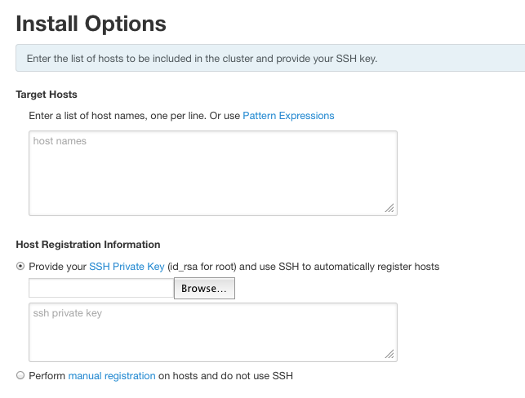
Ambari Cluster Install Wizard
OPTION 1
and
provide SSH Key
OPTION 2

Slide 4
Bootstrap
Operational Flows

Slide 5
Option #1: Ambari Agent Bootstrap (SSH)
Ambari Server
Ambari Agent
1) Configure Ambari Repo
These ops use the SSH key
2) Copy Ambari Agent Setup script
3) Execute Ambari Agent Setup script
4) Install epel-release
5) Install ambari-agent
6) Configure ambari-agent.ini
8) Begin Ambari Agent Registration
7) Start ambari-agent

Slide 6
Option #1: Ambari Agent Bootstrap (SSH)
 | Operation | Description
1 | Configure Ambari Repo | Use the ambari.repo file on the Ambari Server and SCP to Agent host(s).
2 | Copy Ambari Agent Setup script | SCP the setupAgent.py script on Agent host(s).
3 | Execute Ambari Agent Setup script | SSH to Agent host(s) and execute python setupAgent.py
4 | Install epel-release | Install epel-release package using yum / zypper.
5 | Install ambari-agent | Install ambari-agent package using yum / zypper.
6 | Configure ambari-agent.ini | Modify the /etc/ambari-agent/ambari-agent.ini and set the hostname to the Ambari Server hostname.
7 | Start ambari-agent | Start the ambari-agent process.
8 | Begin Ambari Agent Registration | Agent begins the registration process.
** Ambari Server initiates the “bootstrap” process by calling bootstrap.py

Slide 7
Option #2: Ambari Agent Bootstrap (Manual)
Ambari Server
Ambari Agent
No SSH ops are performed
1) Configure Ambari repo
2) Install epel-release
3) Install ambari-agent
4) Configure ambari-agent.ini
6) Begin Ambari Agent Registration
5) Start ambari-agent
** User executes all ops as root no the Agent host(s). No requirement for SSH Private Key.

Slide 8
Agent Registration

Slide 9
Ambari Agent Registration
Ambari Server
Ambari Agent
Agent Host
1) Connect on Handshake port 8441
2) Download Server Cert
3) Request to Sign Agent Cert
4) Sign Agent Cert
5) Download Agent Cert + Disconnect
6) Connect on Registration port 8440
7) Perform 2WAY auth using Agent Cert
8) Get FQDN
8a) Host Script
9) Register host
10) Complete Host Registration
11) Agent Heartbeat Begins

Slide 10
Ambari Agent Registration
 | Operation | Description
1 | Connect on Handshake port 8441 | Ambari Agent connects to Ambari Server on the handshake port.
2 | Download Server Certificate | Ambari Agent downloads the Server Certificate.
3 | Request to sign Agent Certificate | Ambari Agent requests for Ambari Server to sign the Agent Certificate.
4 | Sign Agent Cert | Ambari Server signs Agent Certificate with password.
5 | Download Agent Cert and Disconnect | Ambar Agent downloads Agent Certificate and disconnects.
6 | Connect on Registration port 8440 | Ambari Agent connects to Ambari Server on the registration port.
7 | Perform 2WAY auth using Agent Cert | 2WAY authentication between Agent and Server.
8 | Get FQDN | Ambari Agent host gets the Fully Qualified Domain Name (FQDN) for the Agent host. Note: (8a) In case the host has multiple hostnames, use the host script to echo the hostname to use for registration.
9 | Register Host | Using the FQDN, the Agent host registers with the Ambari Server.
10 | Complete Host Registration | Ambari Server completes the host registration by adding the host to the Ambari DB.
11 | Agent Heartbeat Begins | Ambari Agent starts heartbeat to Ambari Server, checking for commands to execute.

Slide 11
Useful Resources
Resource | Link
Using Custom Hostnames Script | http://docs.hortonworks.com/HDPDocuments/HDP1/HDP-1.2.1/bk_using_Ambari_book/content/ambari-chap7a.html
Manually Registering Ambari Agents | http://docs.hortonworks.com/HDPDocuments/HDP1/HDP-1.2.1/bk_using_Ambari_book/content/ambari-chap6.html

